Slide 1

SRINIVASA INSTITUTE OF ENGINEERING AND TECHNOLOGY
(UGC – Autonomous Institution)
(Approved by AICTE, Permanently affiliated to JNTUK, Kakinada, ISO 9001: 2015 certified Institution)
(Accredited by NAAC with 'A' Grade; Recognized by UGC under sections 2(f) & 12(B))
NH-216, Amalapuram-Kakinada Highway, Cheyyeru (V), AMALAPURAM -533216.
DEPARTMENT OF COMPUTER SCIENCE AND ENGINEERING
BATCH-9
House Price Trends Analysis Using Real Estate Data
Under the esteemed Guidance of
Mr. M Ramakrishna Raju M.Tech
Assistant Professor
Presented by:
B.HEMA LAKSHMI(226N1A0512)
A.SATYA SIRI CHANDANA(226N1A0502)
G. SATYA SINDHUR(226N1A0544)
CH. BABI SRI VENKAT(226N1A0518)
07/1/2026
DEPARTMENT OF COMPUTER SCIENCE AND ENGINEERING
page no : 01

Slide 2

CONTENTS
Abstract
Objectives
Introduction
Literature Survey
Existing System
Proposed System
System Requirements and Specifications
System Architecture
Algorithm
page no : 02
07/1/2026
DEPARTMENT OF COMPUTER SCIENCE AND ENGINEERING

Slide 3
ABSTRACT
This project addresses the real estate valuation challenge by using Machine Learning to analyze and predict house price trends. By processing large datasets of housing features like square footage, location, and age, we identify the key drivers of property value.
Our model employs advanced Regression techniques to provide accurate price forecasts, helping buyers and investors make data- driven decisions in a volatile market. The proposed system leverages data preprocessing, feature engineering, and statistical analysis to enhance prediction accuracy and reliability. The model captures complex relationships between property attributes and market trends that are difficult to analyze using traditional methods. The solution offers scalability, allowing it to adapt to diverse real estate markets and evolving economic conditions.
07/1/2026
DEPARTMENT OF COMPUTER SCIENCE AND ENGINEERING
page no : 03

Slide 4
OBJECTIVES
This project analyzes historical real estate data to study house price trends. Machine Learning regression models are used to accurately predict property prices.
Important features such as location, size, amenities, and age are identified and analyzed. Data preprocessing and feature selection are applied to enhance prediction accuracy . Price trends are visualized across different regions and market segments. The system provides an automated and unbiased tool for real estate valuation.
page no : 04
07/1/2026
DEPARTMENT OF COMPUTER SCIENCE AND ENGINEERING

Slide 5
INTRODUCTION
The real estate industry is a major pillar of the economy, playing a vital role in financial growth and urban development. However, property pricing often lacks consistency due to reliance on subjective judgments, broker expertise, and limited data-driven analysis. Traditional valuation methods struggle to capture complex market dynamics and changing trends.
With the advancement of Machine Learning, real estate analysis is shifting toward data-driven decision-making. By analyzing historical property data, Machine Learning models can identify hidden patterns and key factors influencing house prices. This project applies predictive analytics to transform subjective property valuation into accurate and reliable quantitative predictions, enabling better insights into real estate market trends.
07/1/2026
DEPARTMENT OF COMPUTER SCIENCE AND ENGINEERING
page no : 05

Slide 6
LITERATURE SURVEY
1.Hedonic Regression (2022)
Author: J. Smith, A. Kumar
This study analyzed the impact of individual housing features such as location, size, and amenities on property prices using linear regression techniques. The results showed that location was the most dominant factor influencing price. However, the model struggled to capture non-linear relationships in complex real estate markets, limiting prediction accuracy.
07/1/2026
DEPARTMENT OF COMPUTER SCIENCE AND ENGINEERING
page no : 06

Slide 7
2.Random Forest Valuation (2023)
Author: Lee et al.
The authors applied Random Forest, an ensemble Machine Learning technique, to predict house prices using real estate datasets with missing values. The model achieved higher accuracy compared to traditional Ordinary Least Square regression. The study proved that tree-based models perform better in handling non-linear relationships and feature interactions.
07/1/2026
DEPARTMENT OF COMPUTER SCIENCE AND ENGINEERING
page no : 07

Slide 8
3 .Gradient Boosting Price Prediction (2024)
Author: Wang et al.
This research implemented Gradient Boosting algorithms to improve real estate price prediction accuracy. The model effectively captured complex market patterns and reduced prediction error. However, the approach required higher computational resources and careful parameter tuning, highlighting the need for optimization in large-scale datasets.
07/1/2026
DEPARTMENT OF COMPUTER SCIENCE AND ENGINEERING
page no : 08

Slide 9
4. Neural Network–Based House Price Prediction (2023)
Author: Patel et al.
This study applied Artificial Neural Networks (ANN) to predict house prices using multiple property features and historical market data. The model successfully learned complex non-linear relationships between inputs and prices, achieving improved prediction accuracy compared to traditional regression methods. However, the approach required large training datasets and higher computational resources, which limited its practical deployment in real-time systems.
07/1/2026
DEPARTMENT OF COMPUTER SCIENCE AND ENGINEERING
page no : 09

Slide 10
EXISTING SYSTEM
Now-a-days, house price estimation is mostly carried out using traditional valuation methods that rely on manual analysis, broker experience, and local market knowledge. These approaches often lack accuracy due to limited data processing and subjective decision-making. Existing systems generally use basic statistical techniques that fail to capture complex relationships between multiple property features such as location, size, amenities, and market conditions. As a result, price predictions are inconsistent and may not reflect real-time market trends, leading to unreliable property valuation and decision-making.
07/1/2026
DEPARTMENT OF COMPUTER SCIENCE AND ENGINEERING
page no : 10

Slide 11
DISADVANTAGES
Highly dependent on human judgment
Low prediction accuracy
Cannot handle complex data patterns
Time-consuming manual process
No real-time market analysis
Prone to human bias and errors
Limited scalability for large datasets
07/1/2026
DEPARTMENT OF COMPUTER SCIENCE AND ENGINEERING
page no : 11

Slide 12
PROPOSED SYSTEM
The proposed system uses Machine Learning techniques to automate and improve house price prediction. A robust ML pipeline is developed using Python and advanced regression algorithms such as XGBoost. The system preprocesses raw real estate data by cleaning missing values and handling outliers. Categorical attributes are converted into numerical features for effective model training.
The model assigns objective weights to important features influencing property prices. It enables accurate and real-time price estimation based on market data. Ensemble learning techniques are used to capture complex pricing patterns. This approach ensures higher accuracy, reduced bias, and reliable trend forecasting.
010/2026
DEPARTMENT OF COMPUTER SCIENCE AND ENGINEERING
page no : 12

Slide 13
ADVANTAGES
High Prediction Accuracy
Zero Human Bias
Instant Price Valuation
Data-Driven Insights
Massive Data Handling
Cost Effective Solution
Automated Trend Analysis
07/1/2026
DEPARTMENT OF COMPUTER SCIENCE AND ENGINEERING
page no : 13

Slide 14
SYSTEM REQIREMENTS AND SPECIFICATIONS
HARDWARE REQUIREMENTS:
RAM: 8 GB (for efficient data processing and model training) Hard Disk / SSD: 500 GB (to store datasets, models, and results) Processor: Intel 3rd generation or higher (for smooth execution of ML algorithms)
SOFTWARE REQUIREMENTS:
Operating System: Windows 10 / Windows 11 Programming Language: Python 3.7 or higher IDLE: Jupyter Notebook (for data analysis, model development, and visualization)
10/2/2026
DEPARTMENT OF COMPUTER SCIENCE AND ENGINEERING
page no : 14

Slide 15
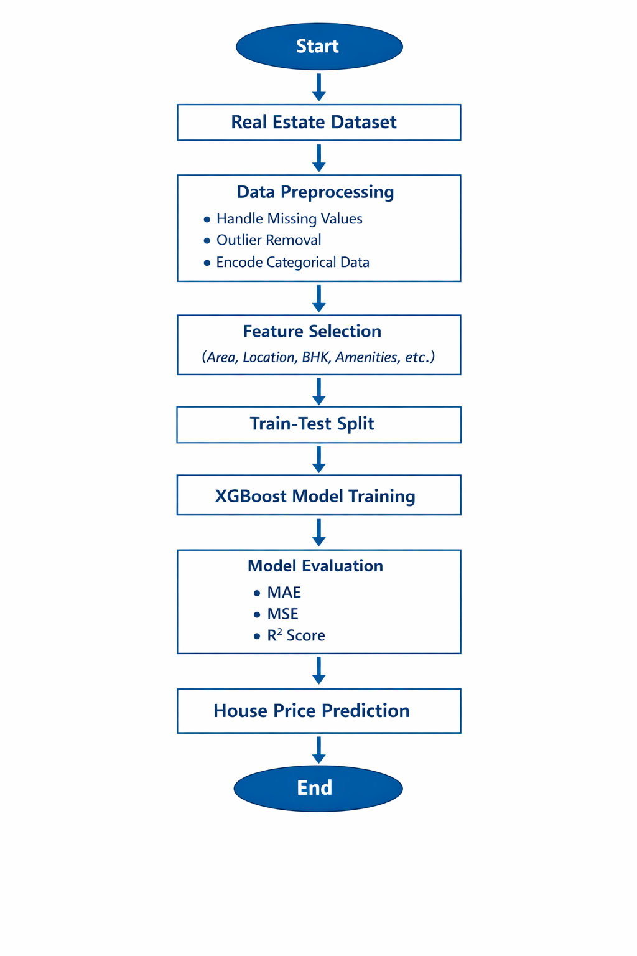
SYSTEM ARCHITECTURE
• Data Source (Real Estate Dataset)
• Data Preprocessing Module
• Feature Selection Module
• XGBoost Model Training
• Model Evaluation
• Price Prediction Output
10/2/2026
DEPARTMENT OF COMPUTER SCIENCE AND ENGINEERING
page no : 15

Slide 16
PROPOSED ALGORITHM
The proposed system uses XGBoost Regression to predict house prices.
It combines multiple decision trees using gradient boosting to improve accuracy.
The model learns complex relationships between housing features and prices.
Our project predicts house prices using XGBoost Regression
XGBoost is an advanced machine learning algorithm based on gradient boosting.
It combines multiple weak decision trees to form a strong predictive model.
The algorithm learns complex patterns from real estate data to improve accuracy.
10/2/2026
DEPARTMENT OF COMPUTER SCIENCE AND ENGINEERING
page no : 16

Slide 17
Step 1: Data Collection
ALGORITHM
Step 2: Data Preprocessing
• Handle missing values
• Remove duplicates and outliers
• Encode categorical variables
• Normalize numerical features
• Collect historical real estate data
• Include features like area, location, BHK, price
• Store data in structured format
10/2/2026
DEPARTMENT OF COMPUTER SCIENCE AND ENGINEERING
page no : 17

Slide 18
Step 3: Model Training
Step 4: Prediction
• Split data into training and testing sets
• Train XGBoost regression model
• Optimize hyperparameters
• Minimize prediction error
• Accept user input (area, location, BHK)
• Process input through trained model
• Generate predicted house price
10/2/2026
DEPARTMENT OF COMPUTER SCIENCE AND ENGINEERING
page no : 18

Slide 19
Thank you
10/2/2026
DEPARTMENT OF COMPUTER SCIENCE AND ENGINEERING
page no : 19

